Slide 1
Chap. 1 Molecular and Biological Chemistry

Slide 2
BIOINFORMATICS ?
BT(Bio Technology) + IT(Information Technology)
Evolution
Developmental
Biology
Transcriptomics
Phylogenetics
Bioinformatics
Genetics
System
Biology
Proteomics
Molecular
Biology

Slide 3
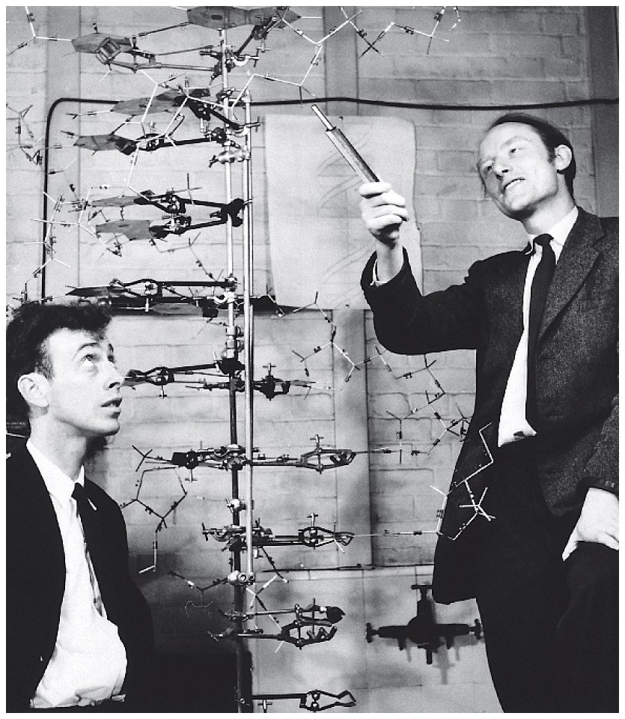
Structure
of
DNA
Notes:
Figure 2.14 American James Watson (left) and Englishman Francis Crick and are shown with the 3-dimensional model of DNA they devised while working at the University of Cambridge in England.

Slide 4
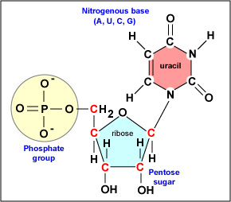
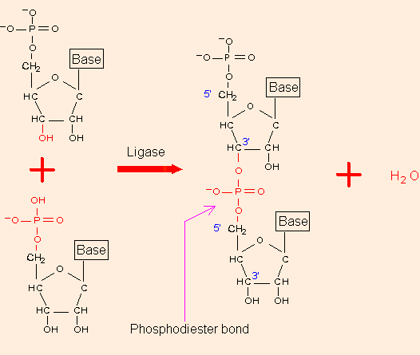
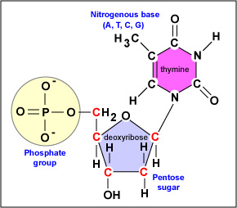
Nucleotides

Slide 5
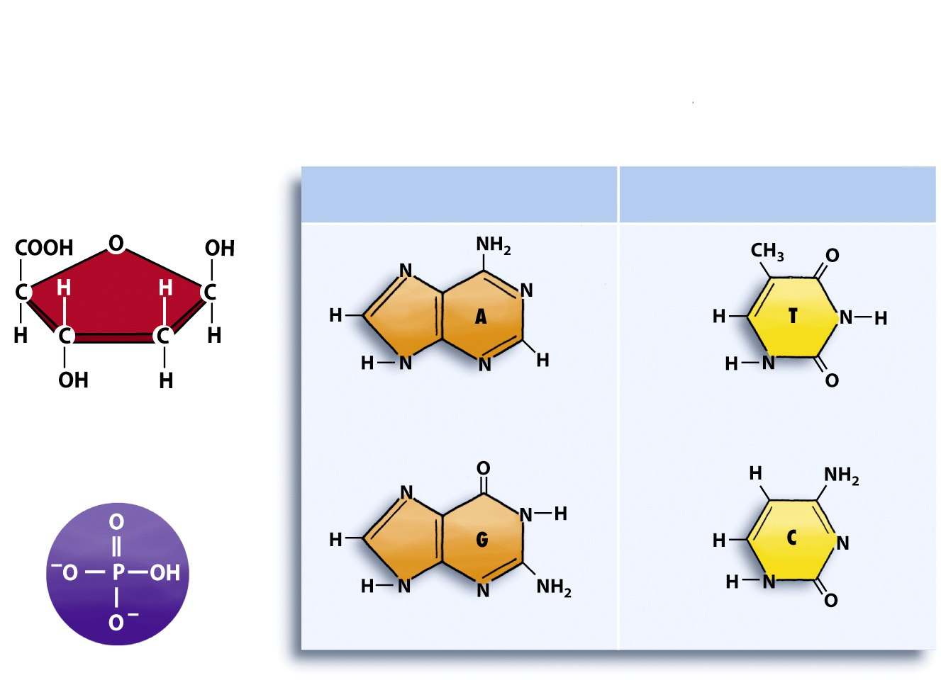
Each nucleotide is composed of a phosphate, a sugar, and a nitrogenous base
Nitrogenous bases
Sugar (S)
Purines
Pyrimidines
A always pairs with T (see part b)
Deoxyribose
Adenine (A)
Thymine (T)
Phosphate (P)
G always pairs with C (see part b)
Guanine (G)
Cytosine (C)
Notes:
Figure 2.13 DNA structure.
(c) A phosphate, a sugar, and a nitrogenous base comprise the structure of a nucleotide. Adenine and guanine are purines, which have a doublering structure; cytosine and thymine are pyrimidines, which have a single-ring structure.

Slide 6
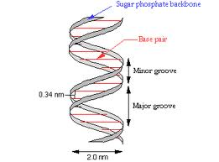
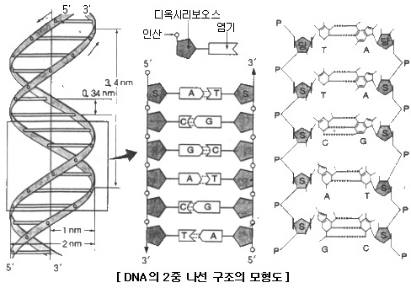
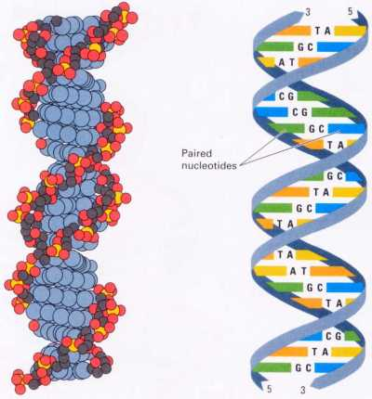
Double-helix
X

Slide 7
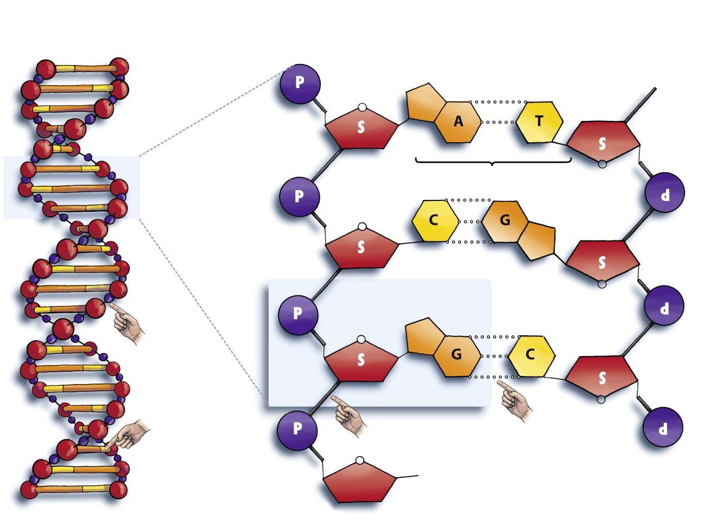
DNA double helix
is made of two strands.
Each strand is a chain of of antiparallel
nucleotides.
“Rung”
Sugar-phosphate “handrail”
Sugar-phosphate “handrail”
Nucleotide
“Handrails” made of sugars and phosphates
Nucleotides within strand are connected
by covalent bonds.
The two strands are connected by hydrogen bonds between the nucleotides.
“Rungs” made of nitrogenous bases
Notes:
Figure 2.13 DNA structure.
(a) DNA is a double-helical structure composed of sugars, phosphates, and nitrogenous bases. (b) Each strand of the helix is composed of repeating units of sugars and phosphates, making the sugar-phosphate backbone, and of nitrogenous bases.

Slide 8
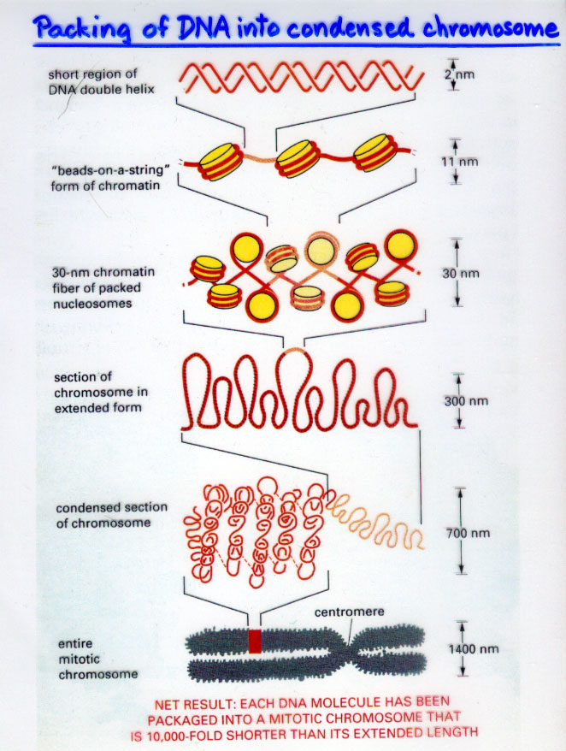
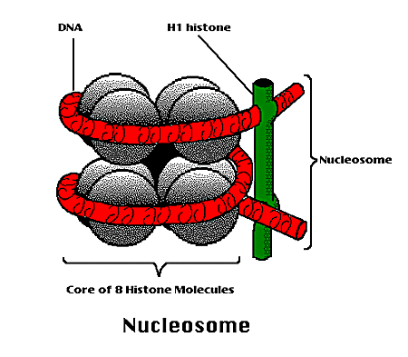
Packing

Slide 9
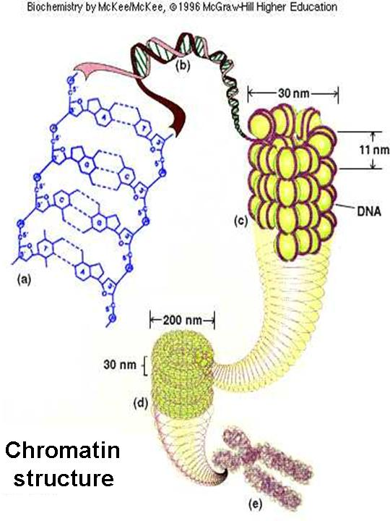
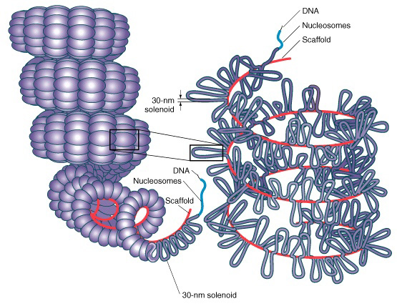

Slide 10
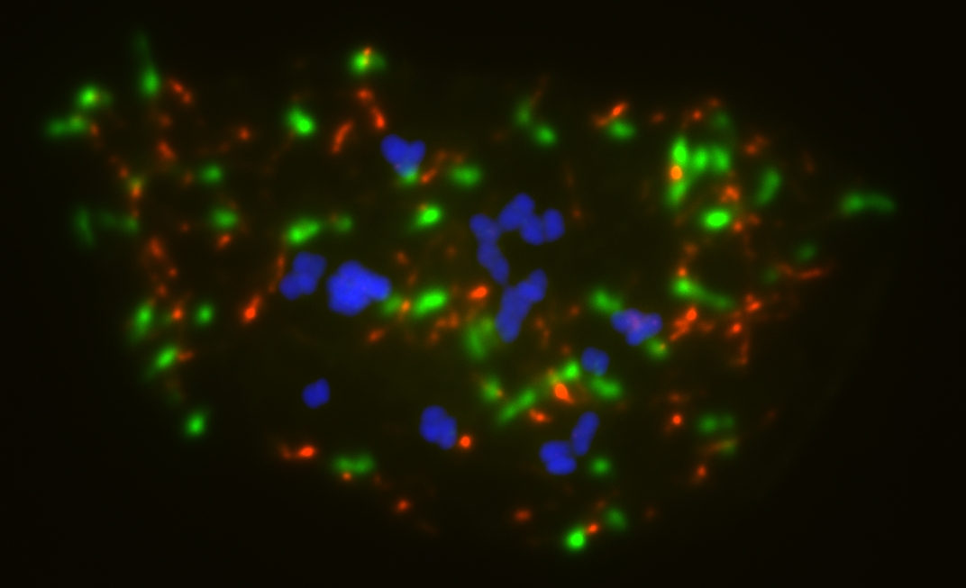
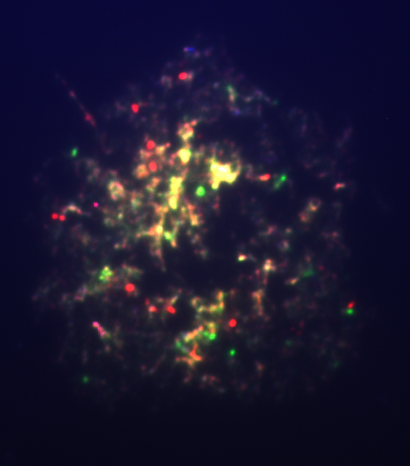
FISH (florescence in situ hybridization) for Amborella trichopoda
Mid-phase
Inter-phase
Blue: nuclear genome
Red: mitochondria genome
Green: chloroplast genome

Slide 11
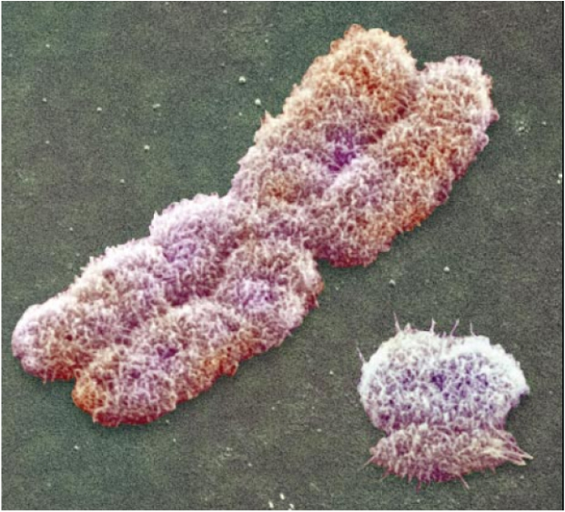
A SEM picture of human chromosome

Slide 12
DNA polymerization
DNA polymerization: DNA polymerase extends a primer by using
a complementary strand as a template.
Unzip first!
3) DNA POLYMERASE
5) Mg⁺⁺
2) PRIMER
5’
3’
T
T
T
G
C
A
A
G
G
G
C
T
…
3’
1) TEMPLETE
A
A
A
C
G
T
T
C
C
C
G
A
G
T
T
C
C
T
C
G
A
G
T
G
T
T
A
C
G
T
T
C
T
T
C
T
C
T
A
G
T
G
T
T
A
C
A
A
A
C
G
T
T
C
C
A
C
G
T
T
C
A
A
A
5’
4) dNTP’s pool
A
T
C
A
A
dATP
T
G
C
dCTP
G
C
G
dGTP
A
C
G
C
T
dTTP
G
T
A
T
G
C
A
T
Newly synthesised strand
5’
G
T
T
T
T
G
C
A
A
G
G
G
C
T
C
A
A
G
G
A
G
C
T
C
A
C
A
A
T
G
C
A
A
G
A
A
G
A
G
A
T
C
A
C
A
A
T
G
T
T
T
G
C
A
A
G
G
T
G
C
A
A
…
3’
A
A
A
C
G
T
T
C
C
C
G
A
G
T
T
C
C
T
C
G
A
G
T
G
T
T
A
C
G
T
T
C
T
T
C
T
C
T
A
G
T
G
T
T
A
C
A
A
A
C
G
T
T
C
C
A
C
G
T
T
C
A
A
A
5’

Slide 13
DNA replication

Slide 14
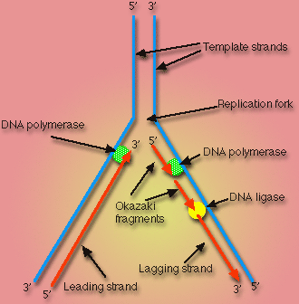
DNA replication 1
DNA replication 2

Slide 15
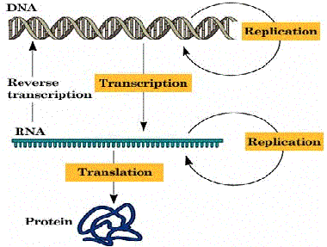
Central Dogma
Reverse-transcription

Slide 16
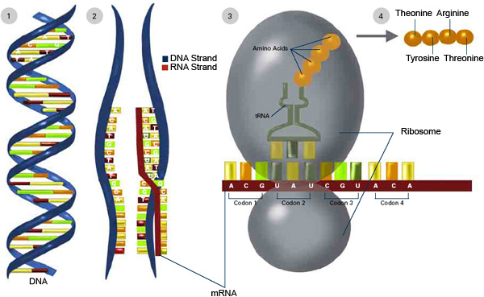
Transcription and Translation
P-site
A-site
Transcription animation
Translation animation

Slide 17
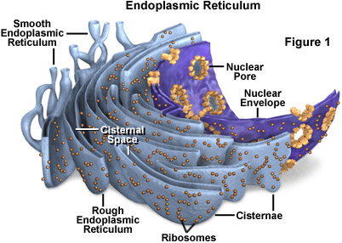
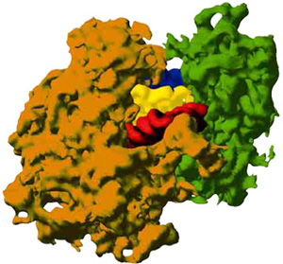
Ribosome
mRNA
rRNA
tRNA
In prokaryotes,
Large subunit = 23S rRNA + 5S rRNA + proteins
Small subunit = 16S rRNA + proteins

Slide 18
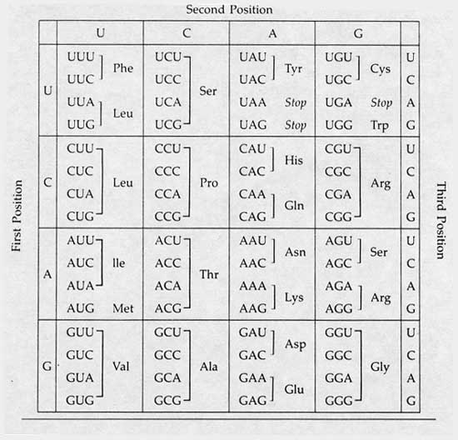
Codon table
Q: 왜 codon은 triple codon 일까?

Slide 19
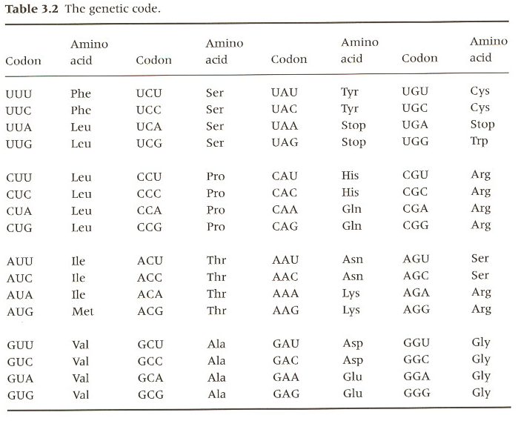
Genetic code
Codon: triple base pairs defining each amino acid.
Why genetic code is triple?
→ double code represents 4² = 16 different information
→ triple code: 4³ = 64 (two much to represent 20 amino acids)
Degenerate site
- twofold degenerate site
- fourfold degenerate site
Synonymous codon
Nonsynonymous codon
Initiation codon: AUG
Stop codon: UAA UAG UGA

Slide 20
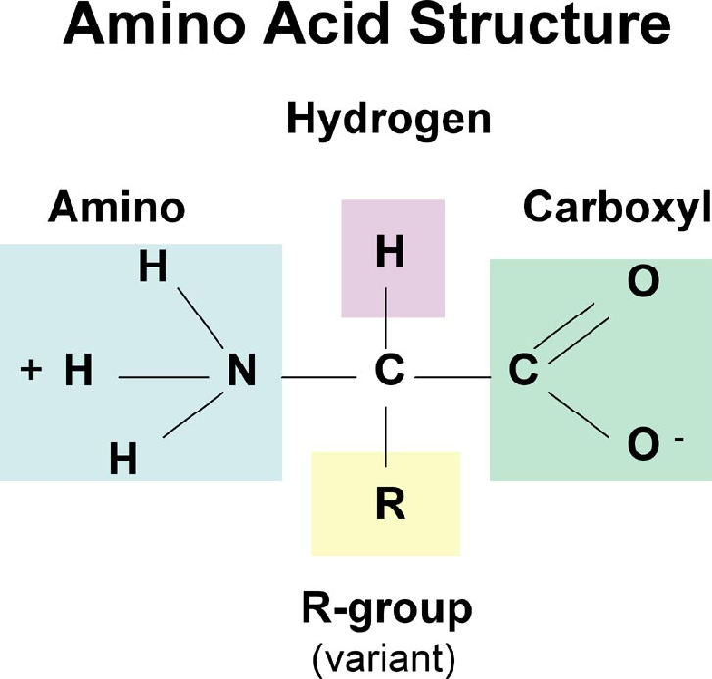

Slide 21
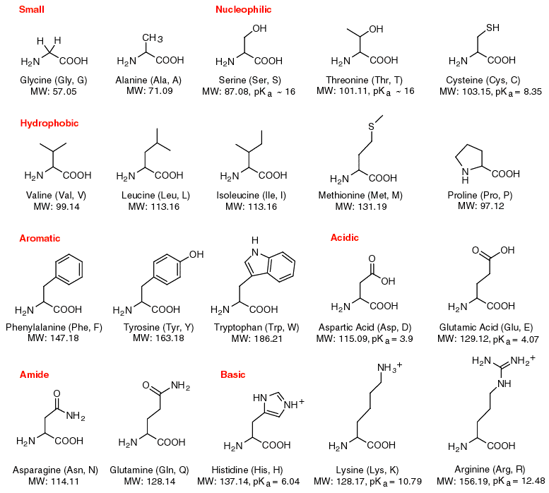

Slide 22
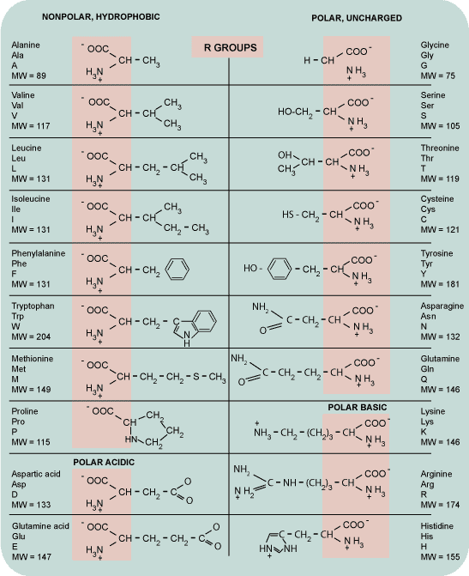
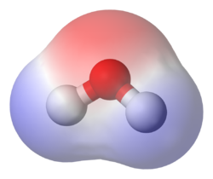
In chemistry, polarity refers to a separation of electric charge leading to a molecule or its chemical groups having an electric dipole or multipole moment.
H2O

Slide 23
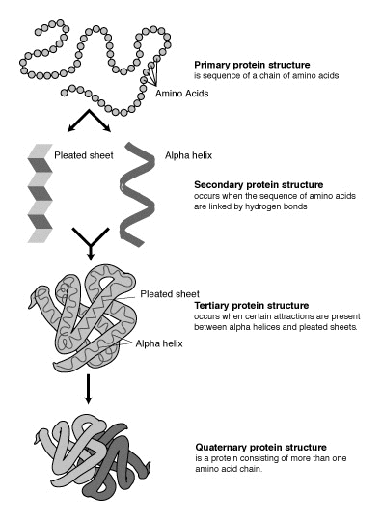
Protein
structure
Protein structure animation
Fold it-protein folding game
Nate news about “Fold it”

Slide 24
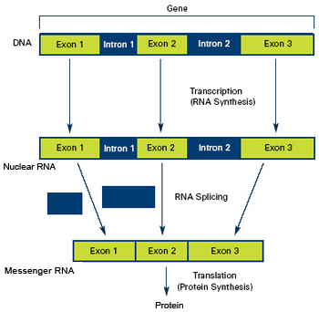
Splicing
Introns: sequences which are discarded during protein synthesis
- nearly always have “GT-----AG” structure
Exons: encode the finished protein
Number, size, and organization of introns varies greatly from gene to gene
- histon: no intron
virus SV40: 31bp
human dystrophin gene: 210,000bp
Splicing animation

Slide 25
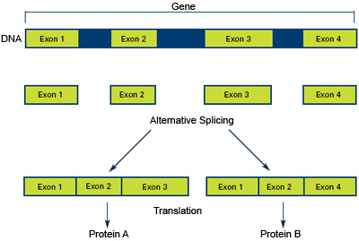
Alternative splicing
Alternative splicing: gives diversity in functional proteins.

Slide 26
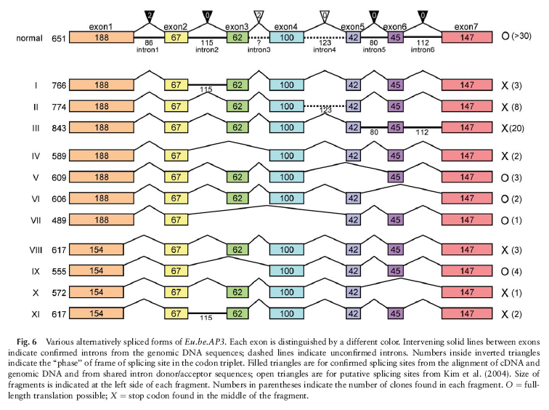
Kim et al., 2005. Sequence and expression studies of A-, B-, and E-CLASS MADS-box homologues in Eupomatia (Eupomatiaceae): support for the bracteate origin of the calyptra. International Journal of Plant Sciences 166: 185-198.
웹사이트의 저널1 확인 하시오.

Slide 27
mRNA Processing
5’ capping
Splicing
3’ tailing

